Slide 1
Android Development
Android Studio, Activities & Fragments

Slide 2
Goals
Develop a BlueSkies App

Slide 3
Agenda
High Level
Android Studio
Overview
Activity
Responsibility
Caveats
Fragment
Responsibility
Caveats

Slide 4
Agenda (cont)
Detail Level
Activity
Lifecycle
Coding Activity
Manifest.xml
XML layout
Activity to Activity communication
Fragment
Lifecycle
Coding Fragment
Fragment to Activity communication
Activity to Fragment communication
XML Layout
Attaching Fragment to Activity

Slide 5
High Level

Slide 6
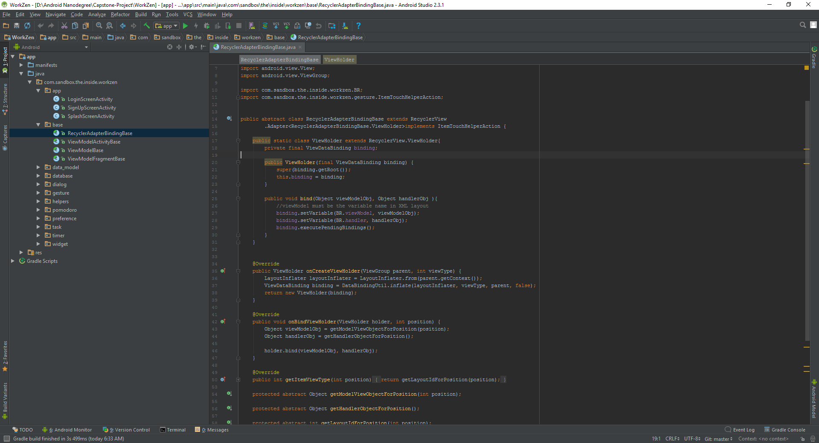
Android Studio
De facto standard for Android development
Built on the IntelliJ
Some features
Layout Editor
Built in emulator
Gradle integration
Instant Run (Hot swap)
https://developer.android.com/studio/index.html

Slide 7

Activity https://developer.android.com/guide/components/activities/index.html
Fundamental building blocks
Entry point for user's interaction
Provides navigates within an app
Communication between other activities
Communication between child fragments
No Creation or Modification of Views

Slide 8

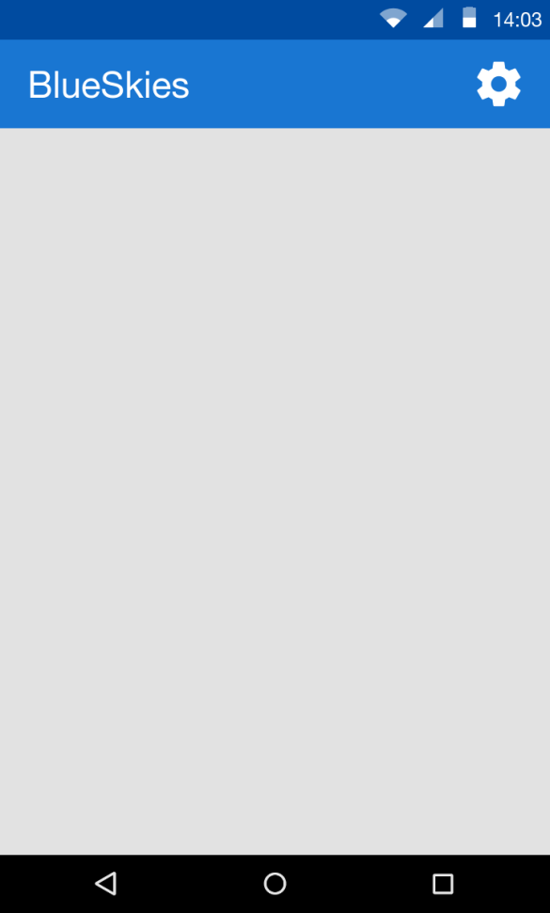
Think of an Activity as a picture frame
=

Slide 9
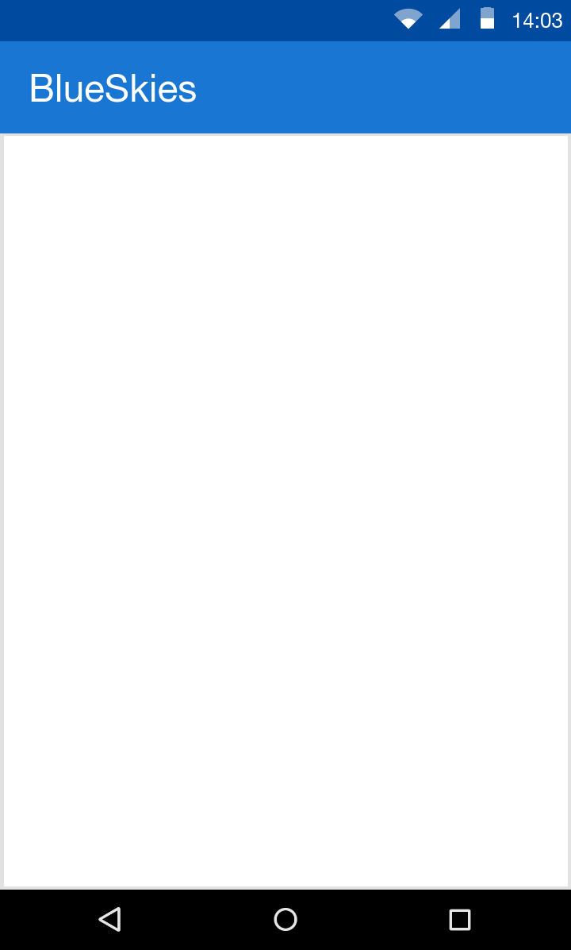

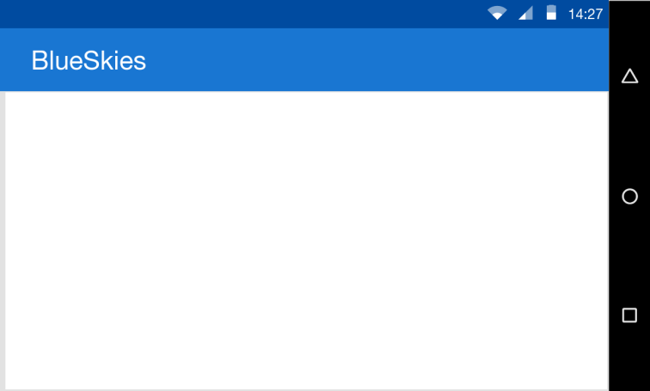
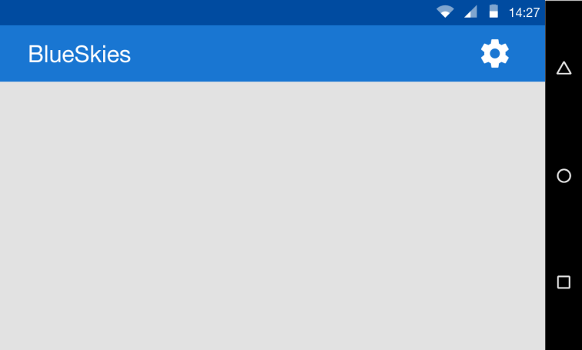

How Activity is like a Picture frame?
Defines the dimensions
Defines orientation, either portrait or landscape
Defines the decorations

Slide 10
Fragment https://developer.android.com/guide/components/fragments.html
View and Layout logic
Event handling (i.e. onClick())
Network request
Interacting with a persistence storage

Slide 11
Detail Level

Slide 12
Activity Lifecycle

Slide 13
Github

